Slide 1
LIQUEFACTION OF GASES

Slide 2
Liquefaction is the transformation of a gaseous substance into its liquid state.
This change is the outcome of change in physical conditions like temperature, pressure, and volume.
Thomas Andrew was the first person to study the change of state from gases to liquids in Carbon Dioxide.
It was later discovered that most real gases behave like Carbon Dioxide (CO₂) and change from gases to liquids if optimum physical changes in temperature and pressure are achieved.

Slide 3
CRITICAL TEMPERATURE, VOLUME, AND PRESSURE
Andrews in his experiment observed that above a specific temperature, the gas sample couldn’t be liquefied, howsoever high the pressure is given.
The critical temperature is the temperature at which a gas changes into liquid.
With the increase in temperature, the pressure required to liquefy a gas also increases.
This temperature was the highest temperature at which a gas appears in the form of a liquid. It is the critical temperature or T_{C}.

Slide 4
Critical constants play an essential role in the change of states of matter.
Critical constants are critical pressure, temperature, and volume.
The volume of one mole of a gas volume liquefied at critical temperature is known as the critical volume (V_{c}).
The pressure required to liquefy the gas at critical temperature is called as the Critical pressure (p_{c}).

Slide 5
Isotherm of Carbon Dioxide
The graph between the Pressure and Volume at a given constant temperature is the isotherm.
On studying the isotherm of Carbon dioxide we get to know the different intervals of temperatures at which a gas can show signs of liquefaction:

Slide 6
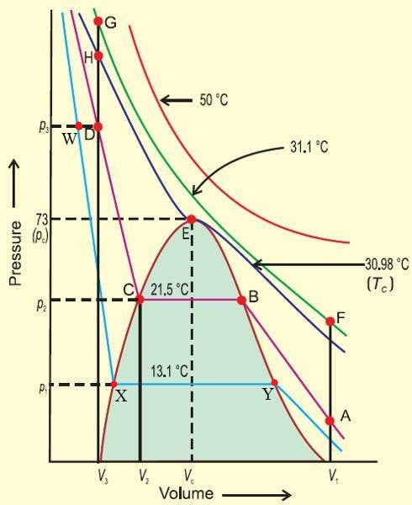
ISOTHERM OF CARBONDIOXIDE

Slide 7
We see that the gaseous state of carbon dioxide changes to liquid at 30.98° C.
The curve changes at a lower temperature, while at the higher temperature it does not show any change.
At 30.98°C, the gas shows considerable deviation from the ideal gas behavior.

Slide 8
On attaining 21.5° Carbon dioxide behaves like a gas until point B.
The point B shows signs of liquid CO₂ .
The gas now exists in the dual form i.e both liquid and gas.
At this stage compressing further does not affect the pressure on the gas, rather it results in condensation.
At point C, all the CO₂ gas has condensed and further compression results in the rise in pressure.
From the above isotherm it is clear that at point A, CO₂ exists in the gaseous state while at point D it exists in a liquid state.
At point D the compression of the liquid CO₂ is almost impossible. At point C an equilibrium state between the two states of matter is seen.

